Slide 1
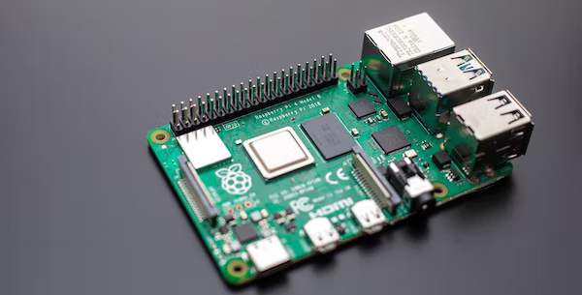
Internet Of Things Lab
Raspberry Pi 4
15/02/23
Dr. Vijay Bhaskar Semval

Slide 2

What exactly is a
Raspberry Pi?
01
A credit-card sized computer
INTERNET OF THINGS
02
Plugs into a monitor or tv
03
Used for exploring computers at low costs

Slide 3
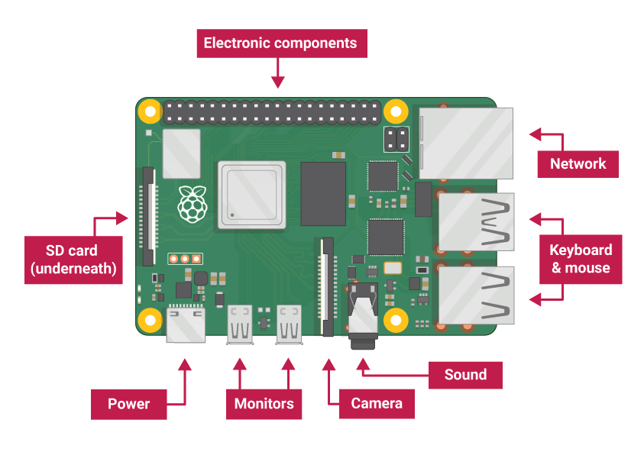
Components of a Raspberry Pi 4
INTERNET OF THINGS

Slide 4
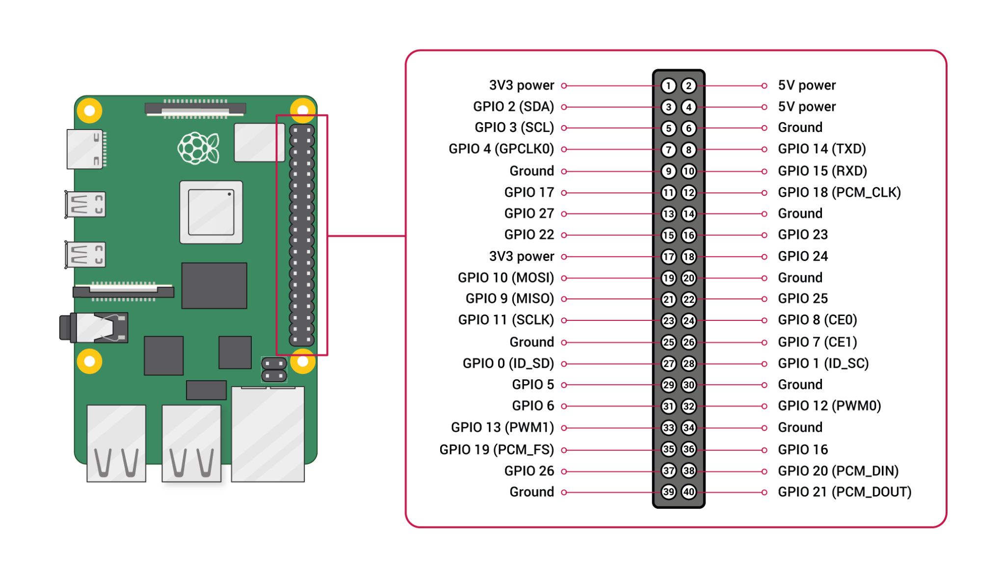
Components of a Raspberry Pi 4
INTERNET OF THINGS

Slide 5
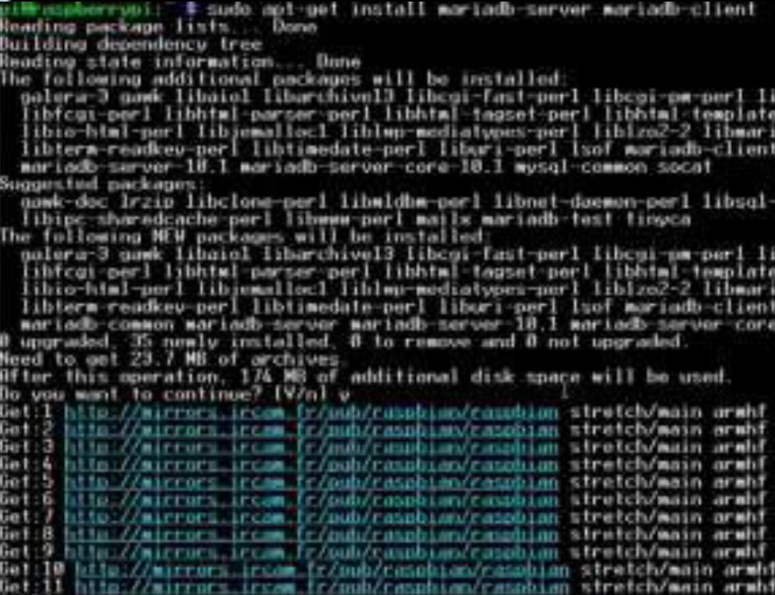
Starter Projects
INTERNET OF THINGS
01
02
03
MySQL Database installation followed by queries for fetching data from the database.
Switch LEDs on or off or in a pattern using Raspberry Pi 4B.
Setup sensors and other peripherals for tiny projects on Raspberry Pi 4B.

Slide 6
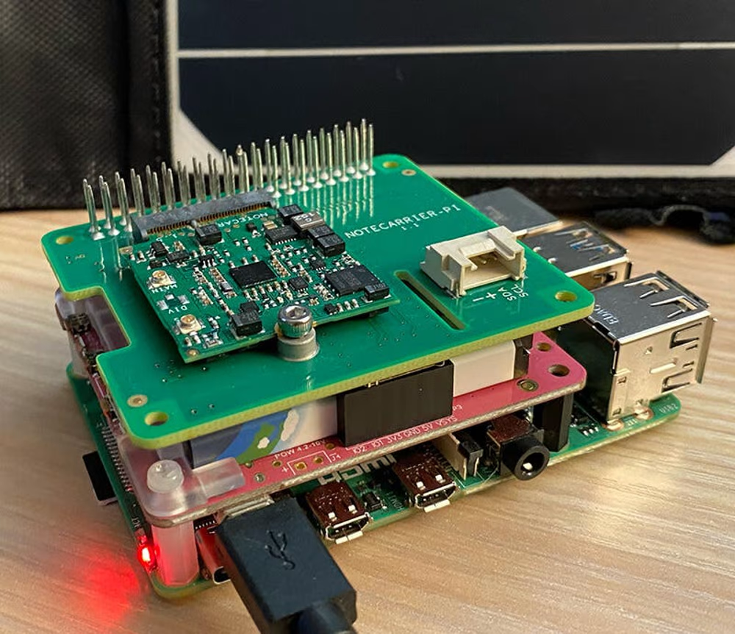
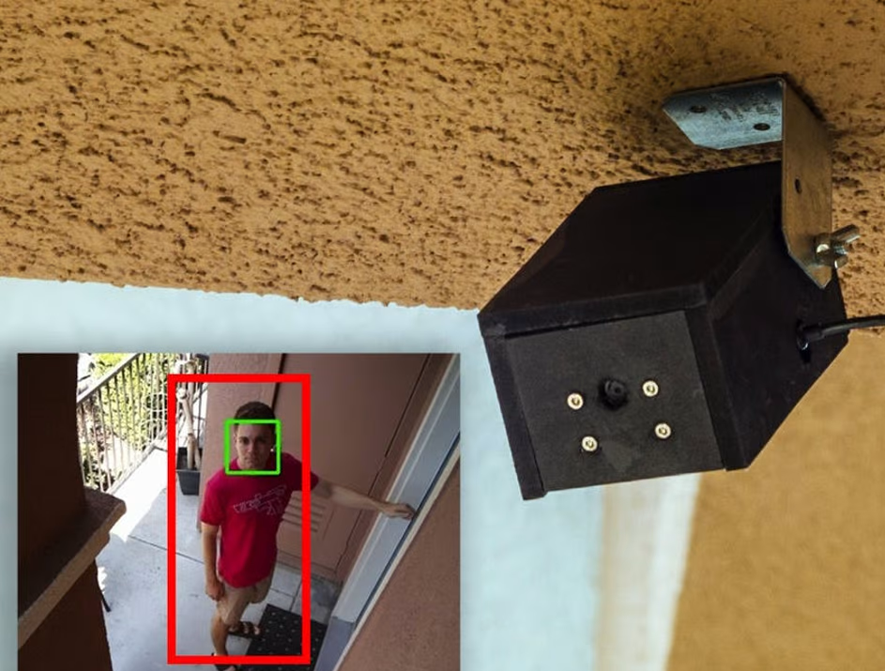
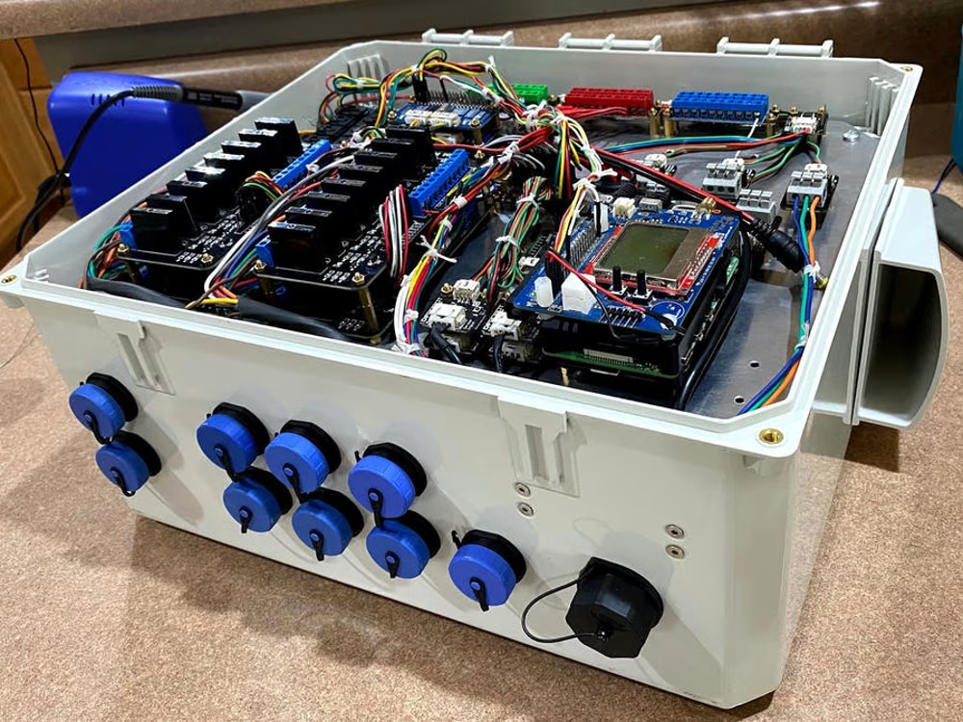
Advanced Projects
INTERNET OF THINGS
01
02
03
Solar powered Bitcoin Miner
Smart Security Camera
Garden Pi- A smart Raspberry Gardener

Slide 7
INTERNET OF THINGS
Thank You!

